Slide 1


Rumah Coding Course "Android Basic"
Studi Kasus Aplikasi "SekolahKu"
Day 1

Slide 2
Course Syllabus
Activity
Menu
ListView
Custom Adapter
SQLite
Resources
View
Layout

Slide 3
Course Overview
Day 1
Day 2
Day 3
Day 4
Final Project
Certificate
Interview
Final Project Duration: 1 Week

Slide 4
Course Breakdown
Day 1
Day 2
Day 3
Day 4
Intro to Android Studio
Intro to Java & XML
Activity
View
Layout
Create Complete Form Activity
Form Validation
Intro to SQLite
Create Model
Save Data
List View
Array Adapter
Custom Array Adapter
Intent
Create Detail Activity
Context Menu
SearchView
Edit Data
Delete Data
Search Data
Add Splash Screen
Activity Lifecycle
Add Login Page
Change Icon
Generate Signed APK
Toast
Menu

Slide 5
Development Tool
JDK 7/8
Android Studio
Big Nox App Player

Slide 6
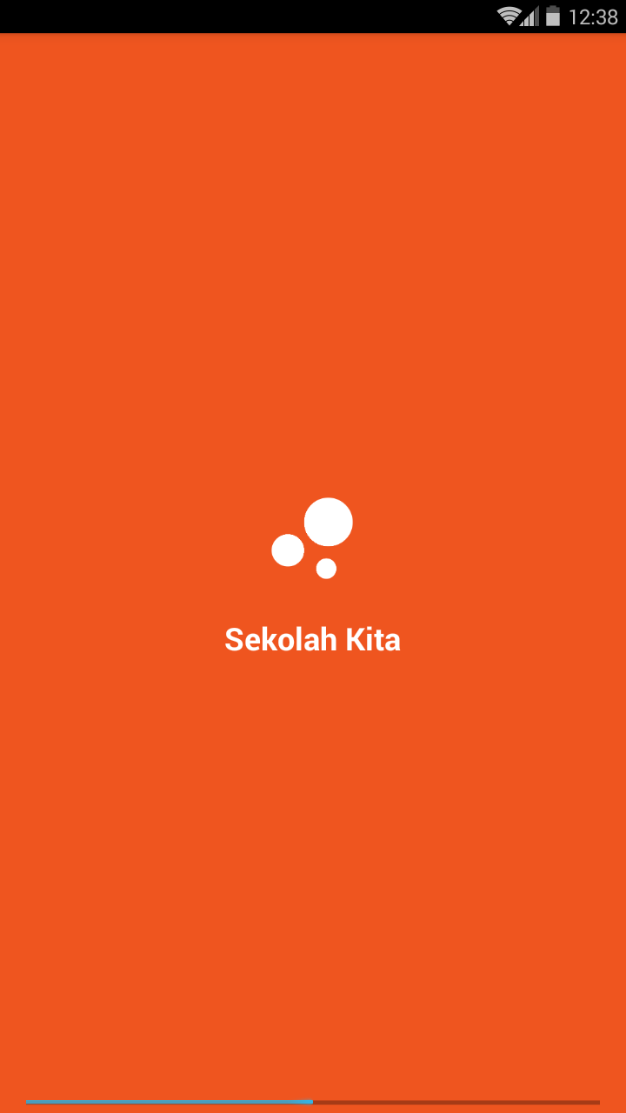
Splash Screen

Slide 7
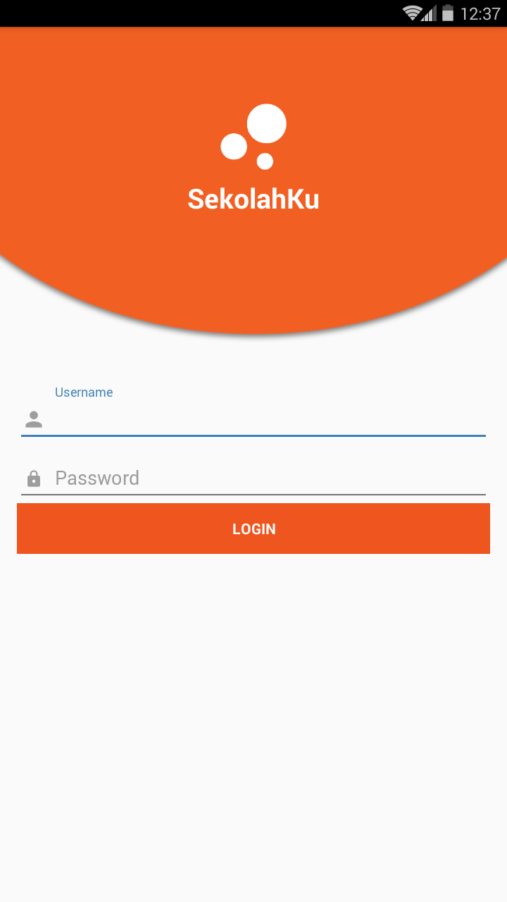
Login Screen

Slide 8
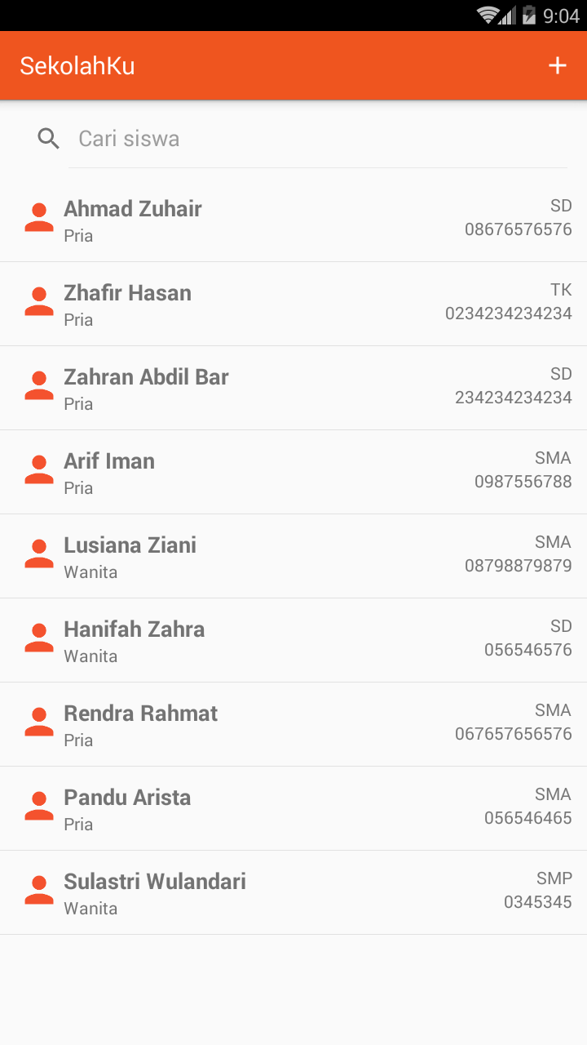
Home Screen

Slide 9
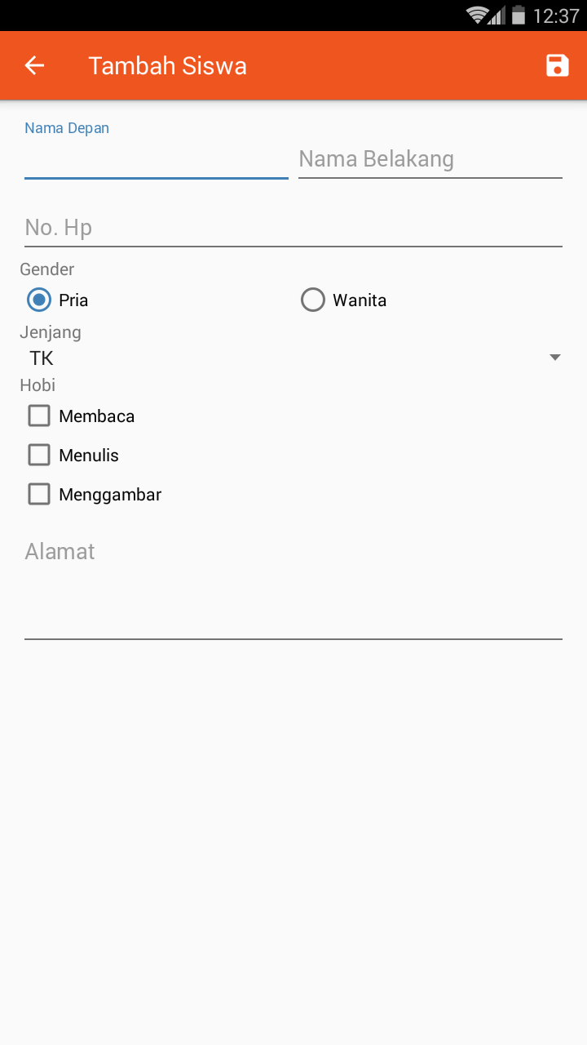
Add Form

Slide 10
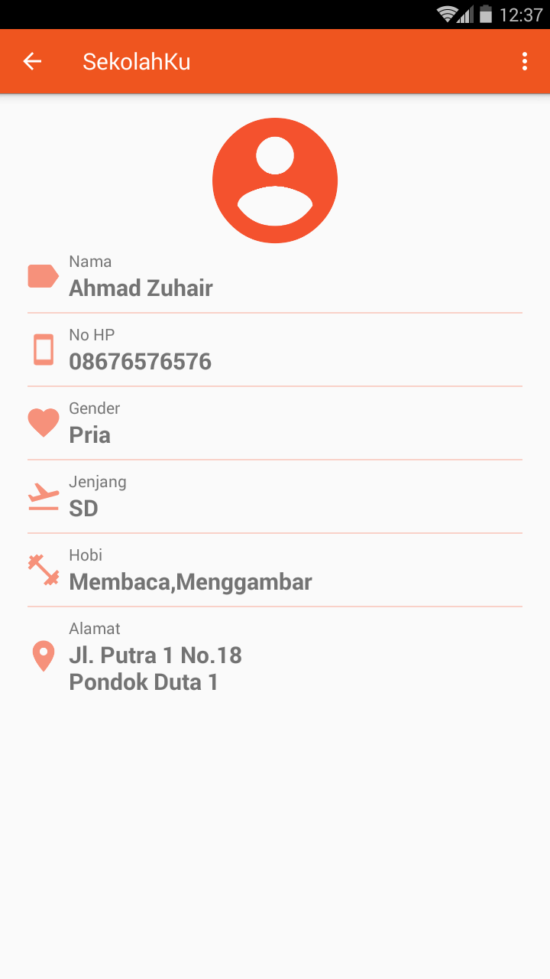
Detail Screen

Slide 11
Try It!
s.id/SekolahKu

Slide 12
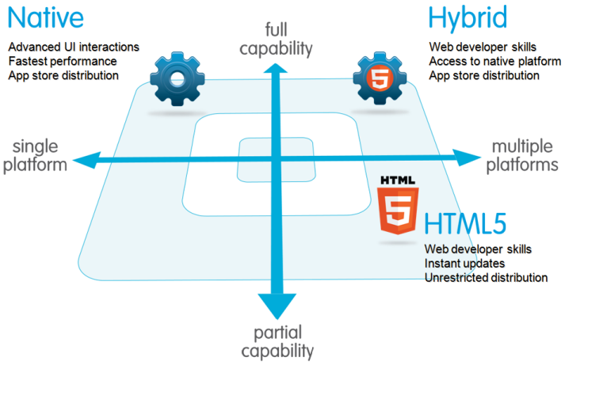
Mobile App Developments

Slide 13
Create New Project
App Name: SekolahKu
Min SDK: 15
Target SDK: 25

Slide 14

Introduction to Android Studio

Slide 15
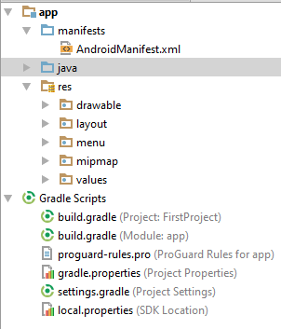
Project Structure

Slide 16
Android Manifest
Every application must have an AndroidManifest.xml file (with precisely that name) in its root directory. The manifest file provides essential information about your app to the Android system, which the system must have before it can run any of the app's code.
It describes the components of the application, which include the activities, services, broadcast receivers, and content providers that compose the application.
It declares the permissions

Slide 17
Java & XML
XML
Define Layout
Act as View
Java
Define Action
Act as Controller

Slide 18
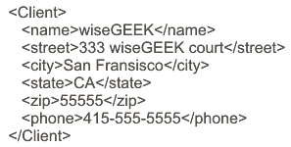
Sample XML Code

Slide 19
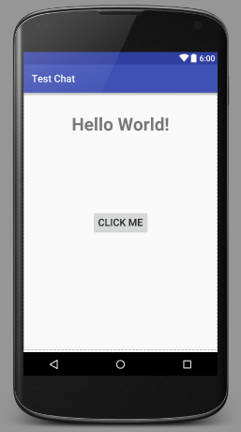
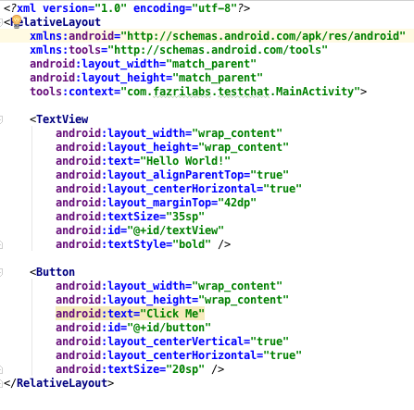
XML

Slide 20
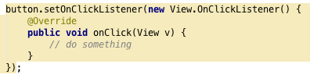
Java
Define an action, ex: Do something when the button is clicked by user

Slide 21

Activity

Slide 22
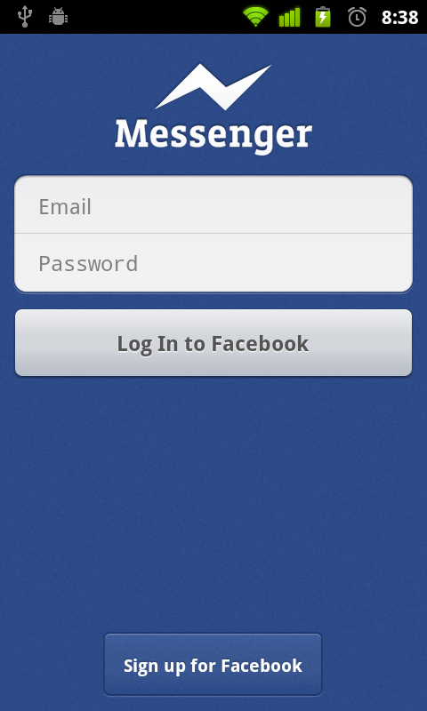
Activity is a screen

Slide 23
Activity consist of Java and XML
Java
XML
Activity

Slide 24
Task #1 Create new activity: TestActivity

Slide 25

View

Slide 26
What is View?
View represents the basic building block for user interface components.
A View occupies a rectangular area on the screen and is responsible for drawing and event handling.

Slide 27
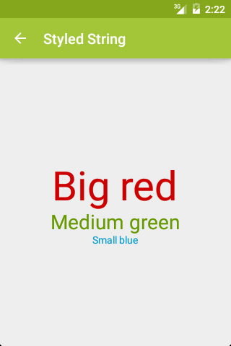
TextView
TextView is a static text. It is used for labeling
Try create some TextView then play with it's attributes.

Slide 28
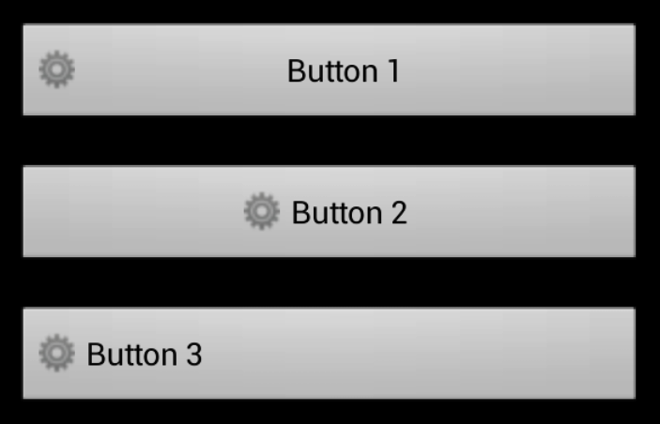
Button
Represents a push-button widget. Push-buttons can be pressed, or clicked, by the user to perform an action.
Try create some Button then play with it's attributes.

Slide 29
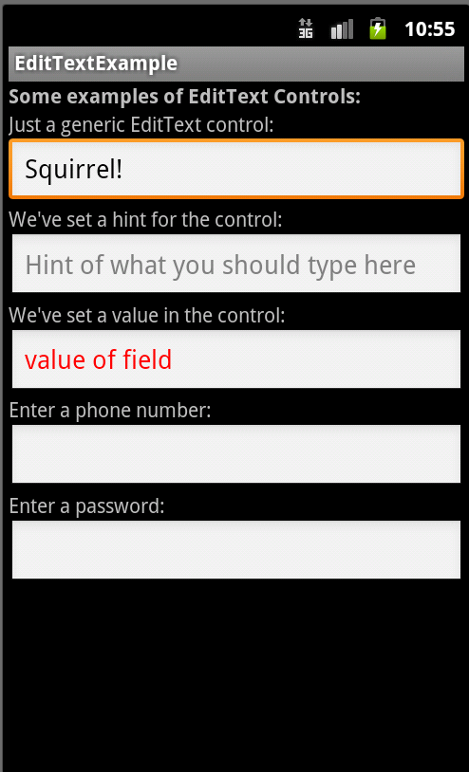
Edit Text
Edit Text is a complete text edit. User can write some text on it
Try create some EditText then play with it's attributes.

Slide 30
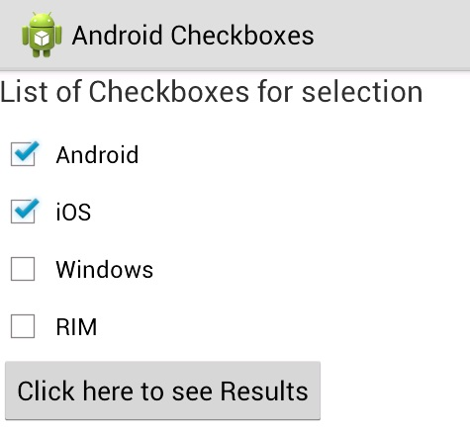
Check Box
A checkbox is a specific type of two-states button that can be either checked or unchecked
Try create some CheckBox then play with it's attributes.

Slide 31
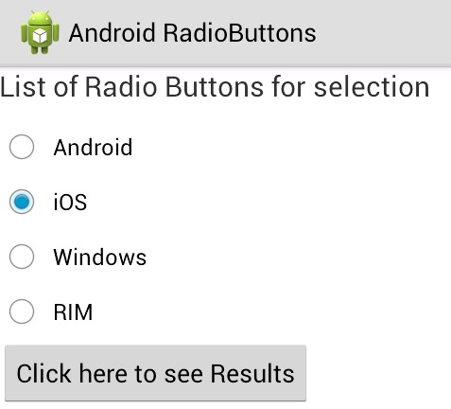
Radio Button
Radio buttons allow the user to select one option from a set.
Try create some RadioButton then play with it's attributes.

Slide 32
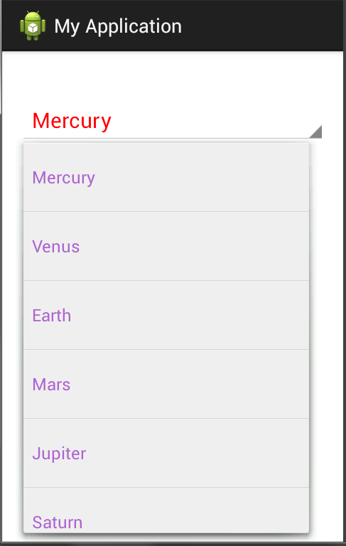
Spinner
Spinners provide a quick way to select one value from a set.
Try create a Spinner then populate items using attribute android:entries

Slide 33
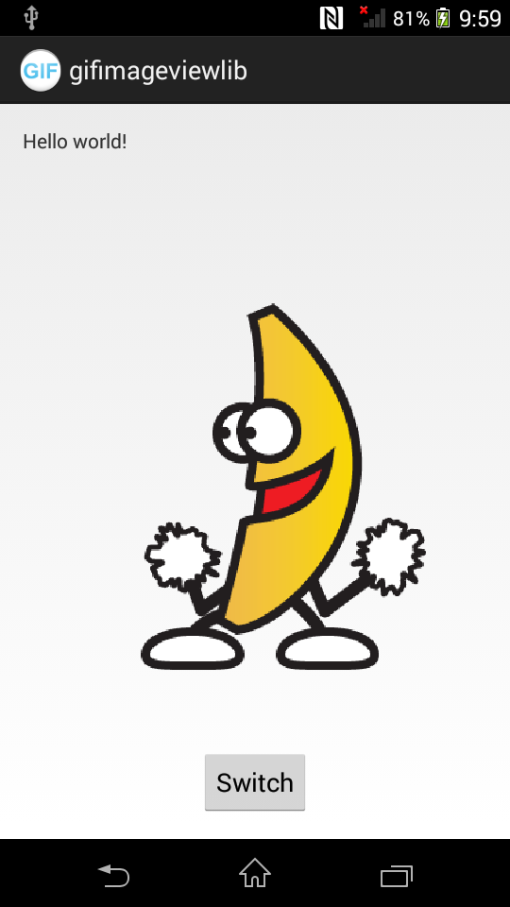
Image View
Displays an arbitrary image, such as an icon, logo or other.
Try create some ImageView using ic_launcher as it's source

Slide 34
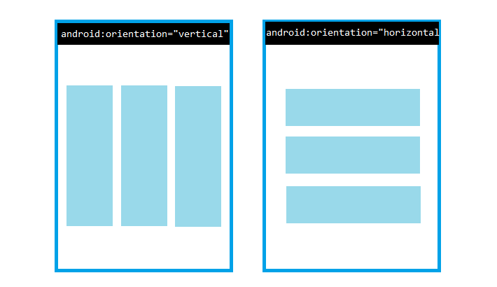
Layout

Slide 35
Linear Layout
Arranges view in vertical or horizontal order

Slide 36
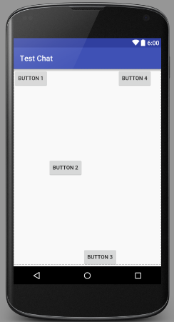
Task #2 Create this layout

Slide 37
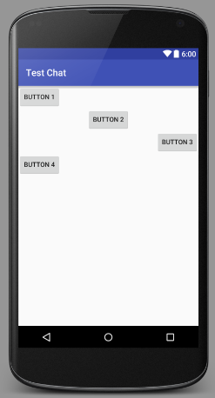
Task #3 Create this layout

Slide 38
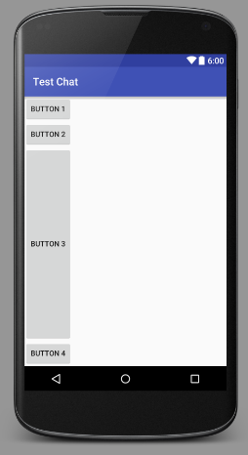
Task #4 Create this layout

Slide 39

Layout Weight
LinearLayout also supports assigning a weight to individual children with the android:layout_weight attribute. This attribute assigns an "importance" value to a view in terms of how much space it should occupy on the screen

Slide 40
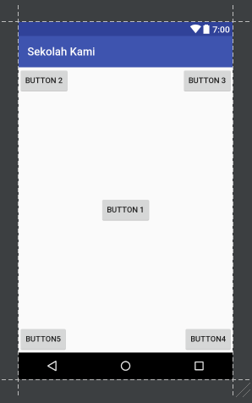
Task #5 Create this layout

Slide 41
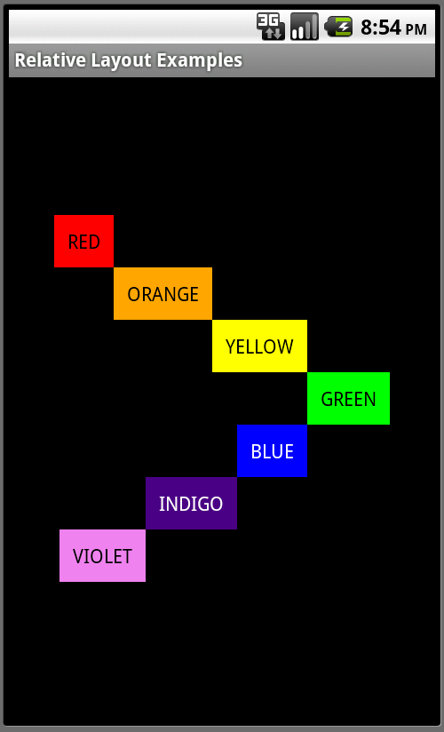
Relative Layout
RelativeLayout is a view group that displays child views in relative positions.

Slide 42
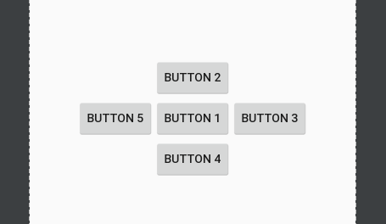
Task #6: Create this layout

Slide 43
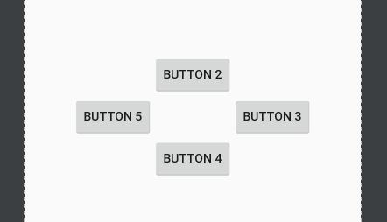
Task #7: Create this layout

Slide 44
Tips for Creating More Complex Layout
Use LinearLayout whenever it's possible.
If it isn't possible to use LinearLayout, You can use RelativeLayout.
You can combine LinearLayout and RelativeLayout as well within a single page to match the required condition.

Slide 45
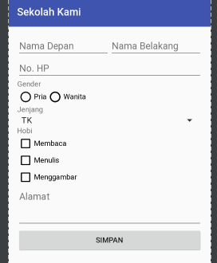
Task #8 Create form activity and create this layout

Slide 46
Padding & Margin
Padding is the space inside the border, between the border and the actual view's content. Note that padding goes completely around the content: there is padding on the top, bottom, right and left sides (which can be independent).
Margins are the spaces outside the border, between the border and the other elements next to this view. In the image, the margin is the grey area outside the entire object. Note that, like the padding, the margin goes completely around the content: there are margins on the top, bottom, right, and left sides.

Slide 47
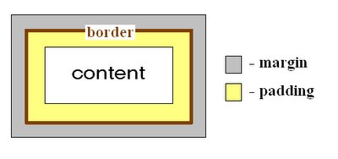
Padding & Margin

Slide 48
Padding & Margin
To give a padding on View, use these attributes:
android:padding (all side)
android:paddingLeft
android:paddingTop
android:paddingRight
android:paddingBottom.
To give a margin on View, use these attributes:
android:layout_margin (all side)
android:layout_marginLeft
android:layout_marginTop
android:layout_marginRight
android:layout_marginBottom.

Slide 49
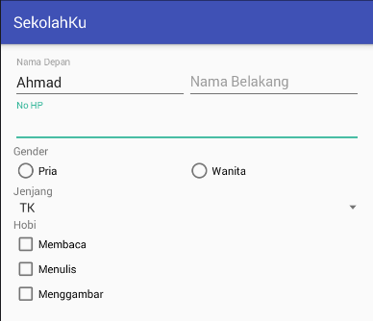
Task #8 Give margin to your Form on all sides.

Slide 50

Set Startup Activity
Open AndroidManifest.xml and add the following code between <activity> tag:

Slide 51
Task #9 Add TextInputLayout to all EditText fields

Slide 52
Scroll View
A view group that allows the view hierarchy placed within it to be scrolled.
Scroll View may have only one direct child placed within it. To add multiple views within the scroll view, make the direct child you add a view group, for example LinearLayout, and place additional views within that LinearLayout.

Slide 53
Task #10 Add ScrollView to FormActivity

